Slide 1
Stream Processing Fundamentals Chapter 20
Joseph Rios & Vignesh Rao

Slide 2
Overview
Background
Stream Processing Use Cases
Motivation
Stream Processing Design Points
Spark’s Streaming APIs

Slide 3
Background

Slide 4
Stream Processing
•Stream Processing is a paradigm that allows applications to more easily exploit a form of parallel processing. Stream processing continuously incorporates new data to compute a result unlike batch processing which runs on historical input data.
•The input data in stream processing has no pre-determined beginning or end, as the input keeps flowing as the data is being processed.
•It simply forms a series of events that arrive at the stream processing system from which the user applications can compute various queries over this stream of events.

Slide 5
Batch & Stream Differences
Stream Processing
Unbounded/Continuous Input data
Runs on a series of events
Computes the result intermittently/keeps it up-to-date
Batch Processing
Fixed Input Dataset
Typically done on historical events
Computes the result once

Slide 6
Batch & Stream Similarities
Both take queries to compute the results
The output of Streaming applications are often files/tables queried in batch jobs
The results from both should match

Slide 7
Stream Processing Use Cases

Slide 8
Notifications & Alerting
Triggering an alert after some series of events occurs
Alerting can be used to notify a user agent when a human interruption is required.
Sometimes alerting can also be used to notify a user about a change in the automated process/current system.
Notification needs to happen quickly
Example: Store running out of a specific item, triggering a notification to the manager to order more or that item.
A notification of heap size from a router buffer can avoid more input which prevents packet loss during data transmission.

Slide 9
Real-time Reporting
Run a real time dashboard for reporting (Eg. Splunk)
Useful for many organizations
The authors present the Databricks Dashboard
Total Platform Usage
Uptime
System load
Usage for new features

Slide 10
Incremental ETL
ETL = Extract, Transform, and Load
Extract: Retrieve data from sources
Transform: Transform data into a consumable format
Load:Transmit data to downstream consumers
Simply making a batch job into a streaming job
Reduces latency
Gets faster and more efficient queries for users
Data processed in fault-tolerant manner
Updates need to be transactional

Slide 11
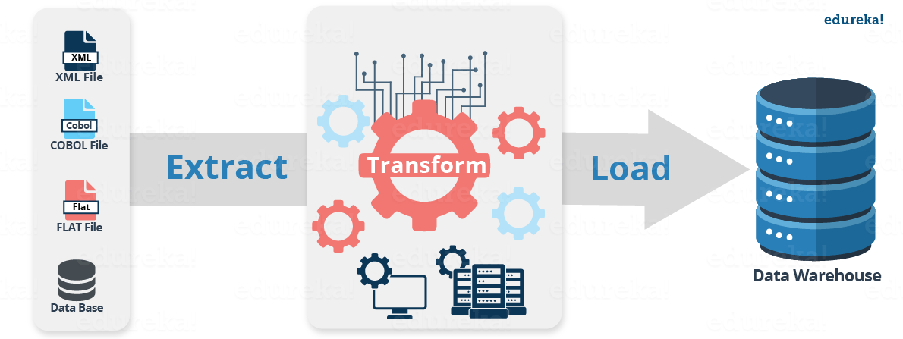
Incremental ETL

Slide 12
Update data to serve in real time
Streaming systems are used to compute data that gets served interactively by another application.
Example: There are some IoT sensors constantly generating data and a web application that lets you view analytics of that data.
The website needs to query the latest data.
Needs support for incremental & transactional updates

Slide 13
Real-time decision making
Involves analyzing new inputs and responding to them automatically using business logic.
Example: A bank trying to catch fraudulent transactions based on recent history.
Decision needs to happen while processing each transaction
Requires you to keep track of a lot of state (i.e. spending patterns)

Slide 14
Online machine learning
As opposed to real-time decision making tracking just one customer’s patterns
Machine Learning Model is trained on all customers
Most Complicated
Aggregate across multiple customers
Join against static datasets
Integrate with ML libraries
Low-latency response times

Slide 15
Motivation

Slide 16
Advantages of Stream Processing
Lower Latency
Ability to respond quickly
Useful for real-time decision making and alerting
More Efficient
As opposed to repeated batch jobs
Incremental Computation means you do not have to run over the data many times

Slide 17
Challenges
Dealing with out-of-order data
Maintaining large amounts of state
Supporting high data throughput
Processing each event exactly once (despite failures)
Handling load imbalance
Responding to events at low latency
Joining with external data in other storage systems
Determining how to update output sinks as new events arrive
Writing data transactionally
Updating business logic at runtime

Slide 18
Stream Processing Design Points

Slide 19
Record-at-a-Time
Pass each event to the application and react to some custom code
Useful for when you need full-control over processing of data
Simply provides the “plumbing” for connecting everything
Used by Apache Storm (and early streaming systems)
Difficult
Need to handle many of the previous challenges yourself
Requires deep expertise to develop/maintain
Notes:
Challenges: tracking state over longer time periods and handling duplicate events after failure.

Slide 20
Declarative APIs
Simply declare what you need, rather than how to compute it
Newer streaming systems use this
Many streaming system provide functional operations like map, reduce, and filter
DStream API
Google Dataflow
Apache Kafka Streams
Structured Streaming actually lets you use relational operations to allow for even more optimization

Slide 21
Event Time vs. Processing Time
Event Time - processing data based on timestamps from the source
Processing Time - processing it when the data is received
Processing Out-of-Order Events
If you’re collecting data from remote sources
Need to keep track of state to handle late arrivals
May not be needed if you’re processing local events
Structured Streaming automatically provides support for event time processing

Slide 22
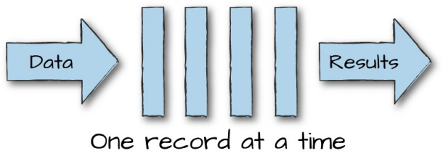
Continuous Processing
Happens on each individual record
Offers lowest possible latency when input rate is relatively low
Lower maximum throughput because of the overhead per-record
Typically has a fixed topology, making it hard to do load balancing

Slide 23
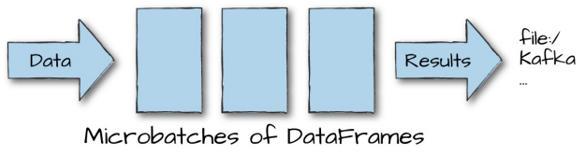
Micro-batch Execution
Waits to accumulate input data and processes each batch in parallel
Can have some of the same optimizations as batch jobs
Has a higher throughput, because it has less per-record overhead
Higher base latency, because it has to wait to accumulate

Slide 24
Spark’s Streaming APIs

Slide 25
DStream
Released in 2012 and is widely used
Based on low-level operations with Java/Python objects
Limited opportunity for higher-level optimization
Based on “Processing Time,” so you have to implement your own event time support
Only works in micro-batch execution mode

Slide 26
Structured Streaming
Available in Scala, Java, Python, R, and SQL
Native support for event time data
As of 2.3, Spark supports both the micro-batch model and the continuous execution model
Designed to combine well into an end-to-end continuous applications
Can perform more types of automatic optimizations, because it is built on Spark’s Structured Data Model
Plans to integrate with MLlib for online machine learning

Slide 27
Goals of Structured Streaming
Make it easy to go from batch applications to streaming
Perform Database-like query optimizations
Provide a unified API for building an end-to-end continuous application

Slide 28
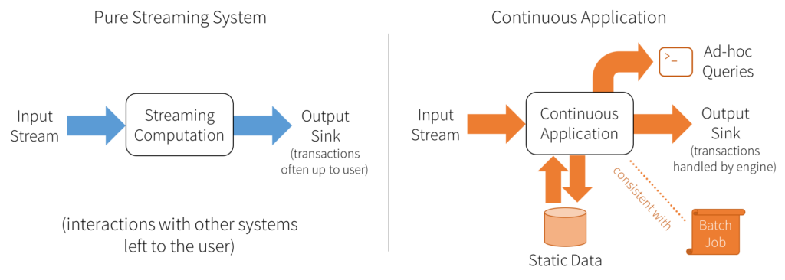
Notes:
https://databricks.com/blog/2016/07/28/continuous-applications-evolving-streaming-in-apache-spark-2-0.html

Slide 29
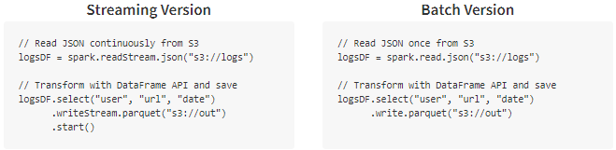
Notes:
https://databricks.com/blog/2016/07/28/continuous-applications-evolving-streaming-in-apache-spark-2-0.html

Slide 30
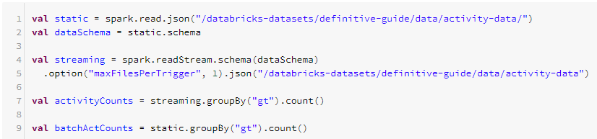
Code Example (1)
Partially pulled from Ch. 21 – (350-351)

Slide 31
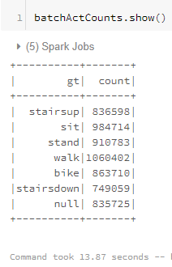
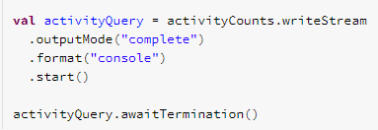
Code Example (2)

